Slide 1
Angular Upskilling Program
Component Lifecycle Hooks

Slide 2
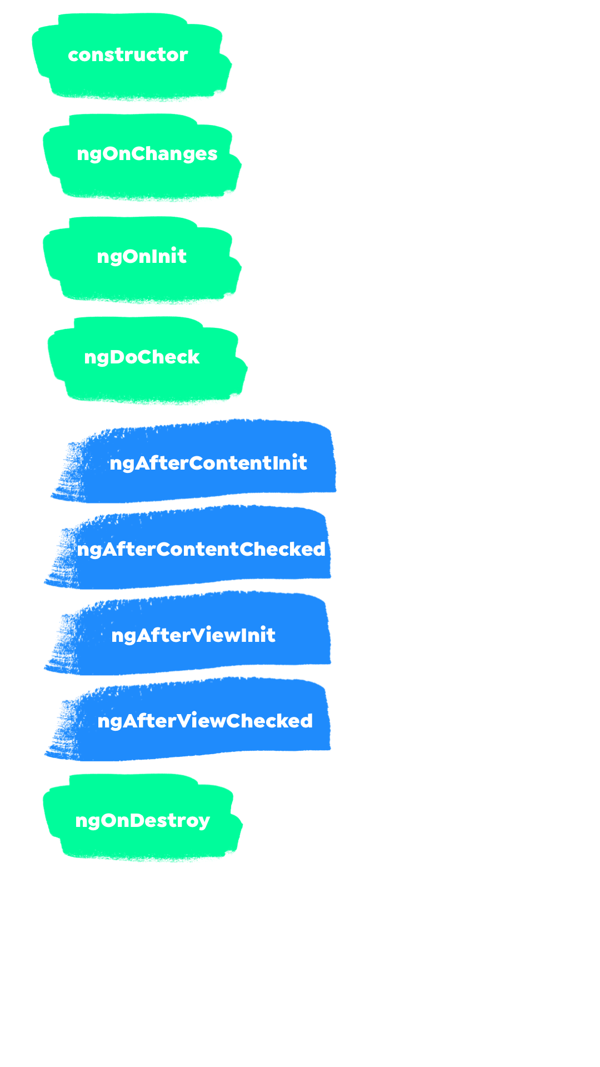
Component Lifecycle Hooks
When we are creating an Angular Component there
are nine special methods called Lifecycle Hooks that
allows us to manage the behaviour of the component
on different parts of its lifespan:
constructor
ngOnChanges
ngOnInit
ngDoCheck
ngAfterContentInit
ngAfterContentChecked
ngAfterViewInit
ngAfterViewChecked
ngOnDestroy

Slide 3
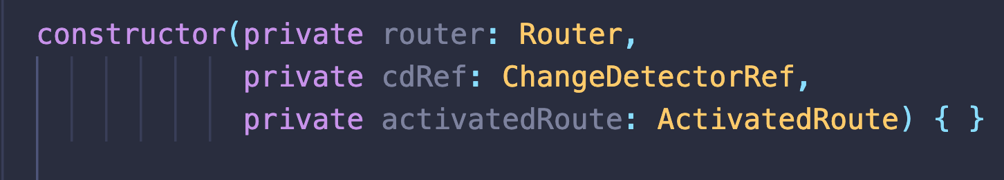
Constructor
The constructor of a component is called once when the component is initialized and it’s used the inject the needed dependencies in the class.
Used to initialize all the @Inputs and @Outputs of a component;
Adds the Component to DOM

Slide 4
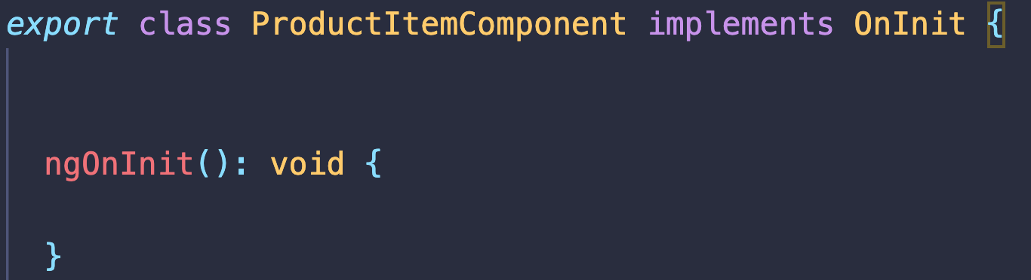
ngOnInit
Guarantees the availability of all the dependencies injected by the component;
Used to perform data fetching operations from the server (Highly recommended to do this operation in ngOnInit);
@Input properties are initialized;
Called only once after the component’s construction;

Slide 5
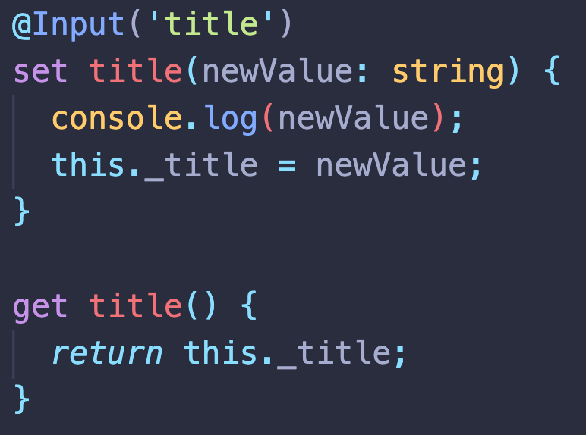
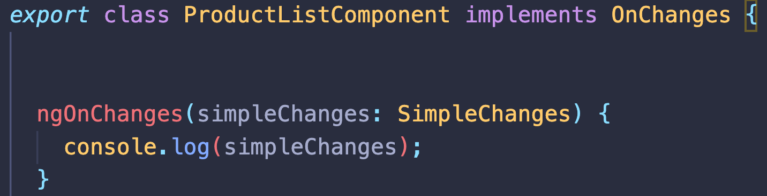
ngOnChanges
Triggered only if the component has any @Input properties;
Used as a watcher over the @Input properties;
Can become pretty hard to monitor if the component has too many @Inputs;
Recommended way is to use setters for the detection of changes;

Slide 6
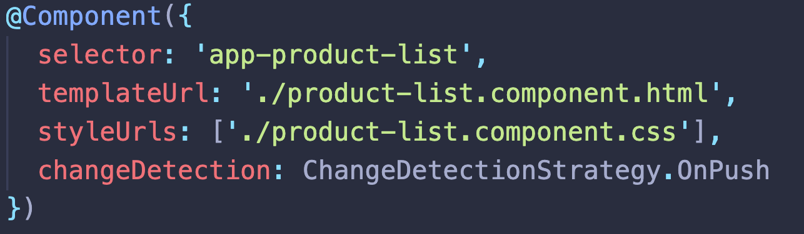
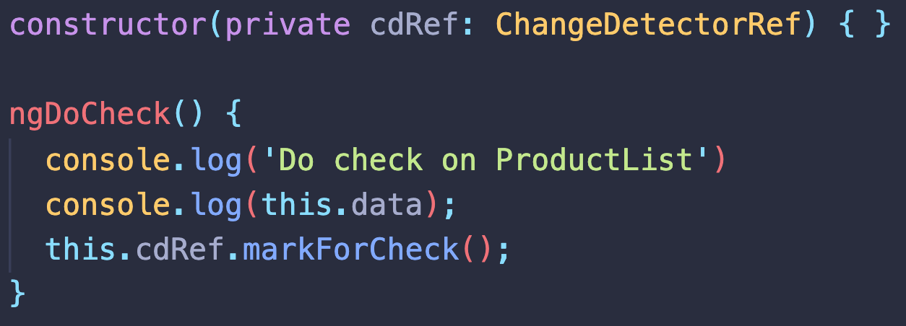
ngDoCheck
Called everytime when change detection mechanism is triggered;
If we change the component change detection strategy it is used to detect the changes from a component;
If changes are applied to @Input properties the change detection mechanism should be triggered manually by using ChangeDetectorRef from @angular/core.
Very usefull for optimization when a component is suffering multiple change detection cycles;

Slide 7
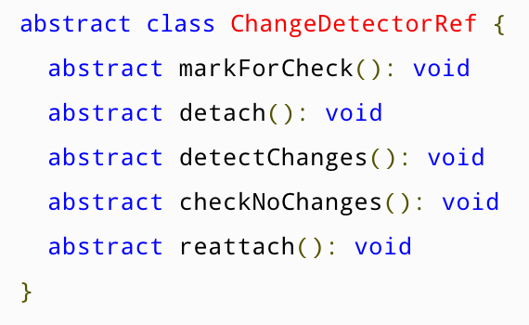
ChangeDetectorRef
Used to manually controll the change detection mechanism
for a component. Contains 5 special methods:
markForCheck();
detach();
detectChanges();
checkNoChanges();
reattach();

Slide 8
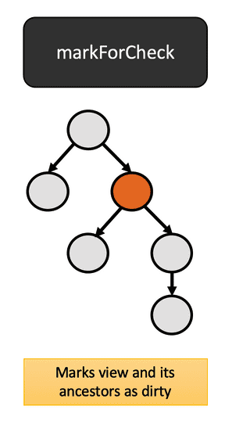
ChangeDetectorRef – markForCheck()
When a view uses the OnPush (checkOnce) change detection strategy, explicitly marks the view as changed so that it can be checked again.
Used to apply the changes for all @Input() properties when the change detector does not reflect the changes in page;
Components are normally marked as dirty (in need of rerendering) when inputs have changed or events have fired in the view. Call this method to ensure that a component is checked even if these triggers have not occured.
Not working if the component is detached from the component change detection tree;

Slide 9
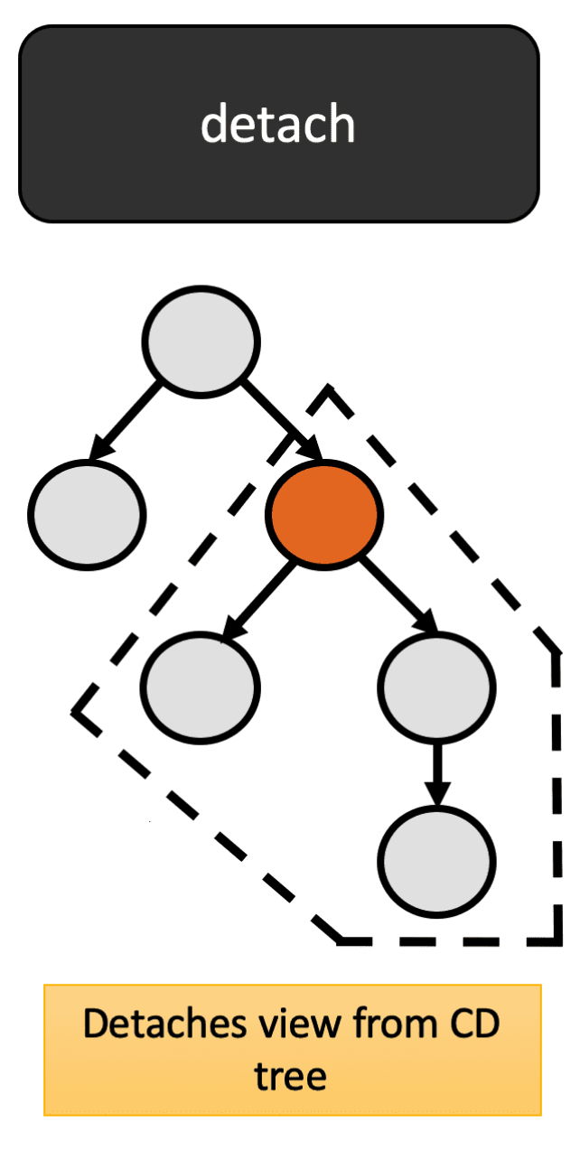
ChangeDetectorRef – detach()
Detaches the component from the application change detection tree;
Used in combination with detectChanges() method;
Detached views are not checked during change detection runs until they are re-attached, even if they are marked as dirty.

Slide 10
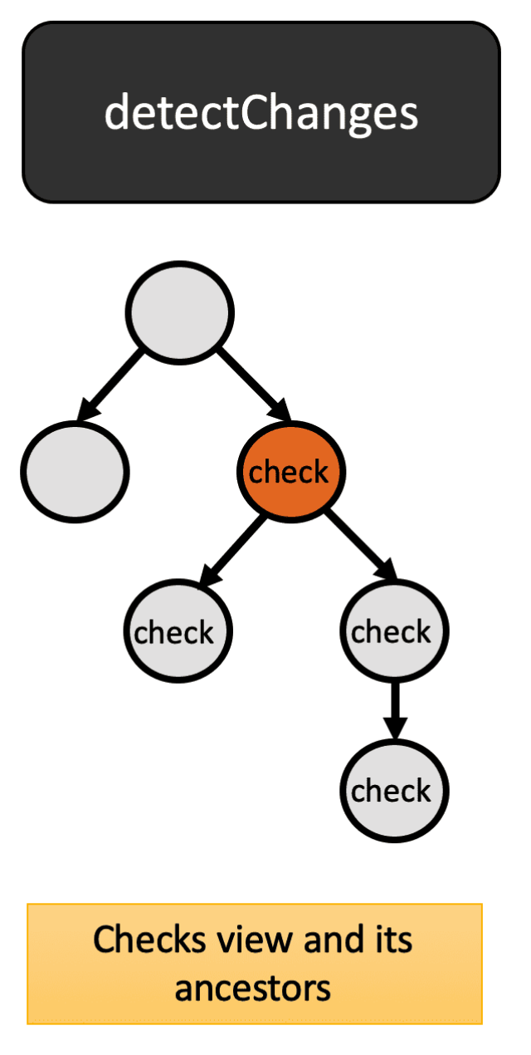
ChangeDetectorRef – detectChanges()
Detached views are not checked during change detection runs until they are re-attached, even if they are marked as dirty.
Used to trigger the change detection on the current view and its children;
It reflects on @Input properties as well;

Slide 11
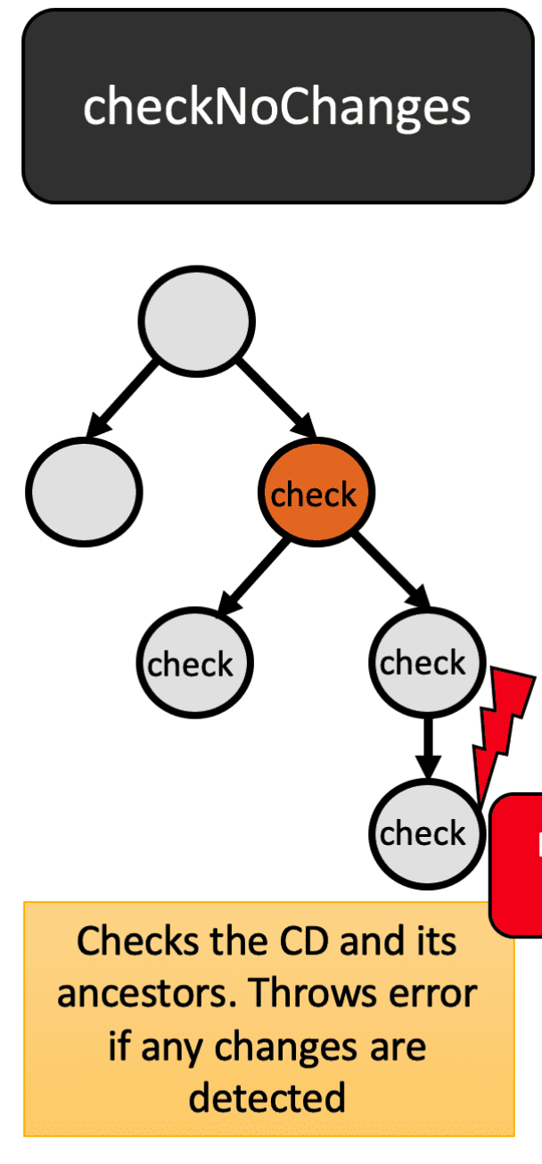
ChangeDetectorRef – checkNoChanges()
Checks the change detector and its children, and throws if any changes are detected.
Use in development mode to verify that running change detection doesn't introduce other changes.

Slide 12
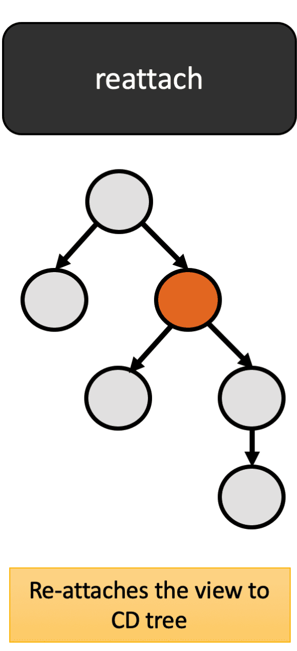
ChangeDetectorRef – reatach()
Re-attaches the previously detached view to the change detection tree.
Views are attached to the tree by default.

Slide 13
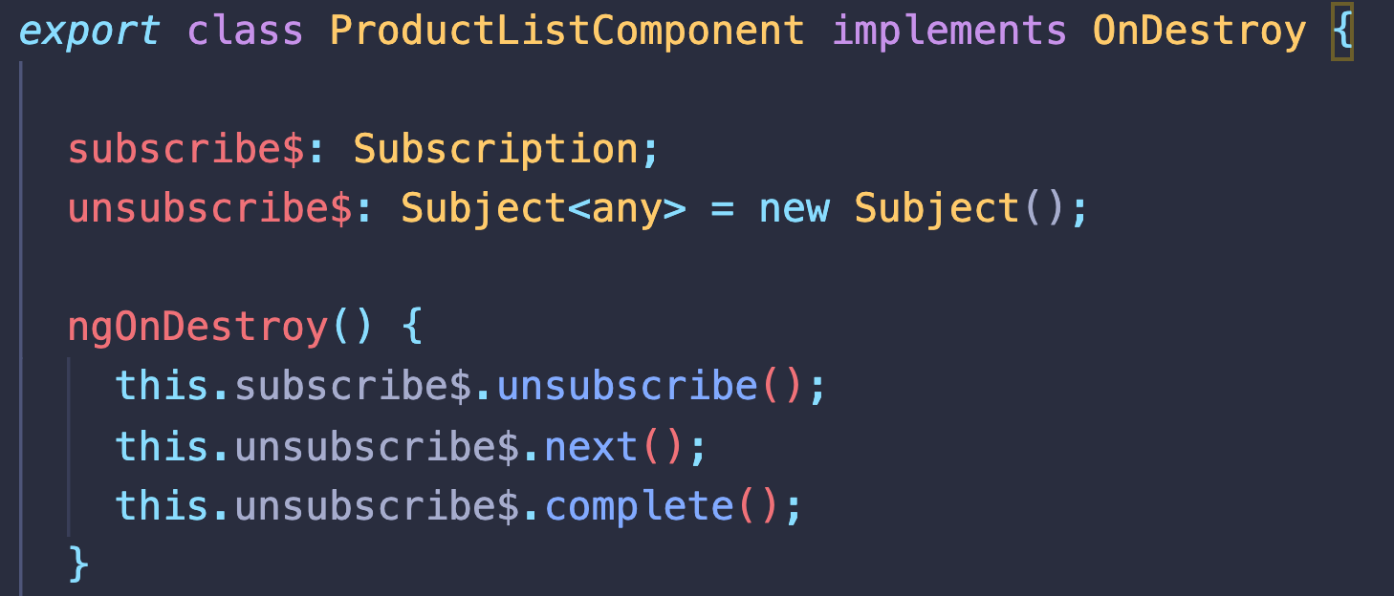
ngOnDestroy
Angular hook that is called when the view is removed from the rendering tree.
Very useful for unsubscribing the observables that are not handled by the framework;
Place to free all event handlers in order to prevent memory leaks;

Slide 14


